Slide 1
Multiplayer Gaming Platform based on mobile cloud computing and recommendation algorithm ——Huang Kai

Slide 2
outline
Gaming platform
Recommendation algorithm
Recommendation in Gaming
Future work

Slide 3
Gaming platform
Background & motivation
Public transit & intelligent terminal
Crowd computing & mobile cloud computing

Slide 4
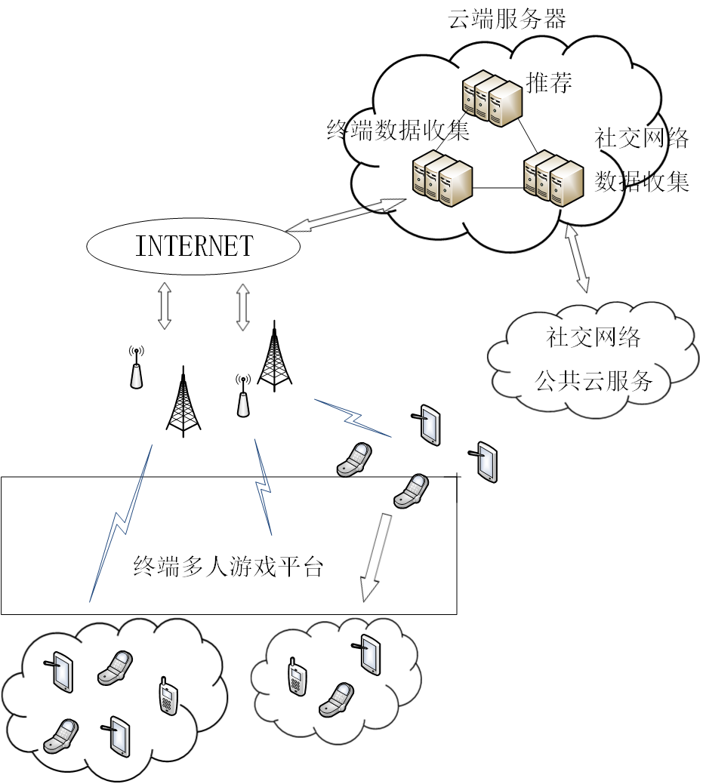
System

Slide 5
Recommendation
Collaborative filtering
Machine Learning
Collective intelligence
User based
Item based

Slide 6
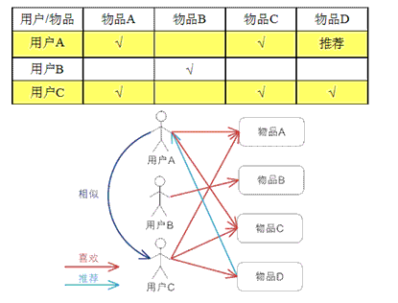
Collaborative filtering
User-based

Slide 7
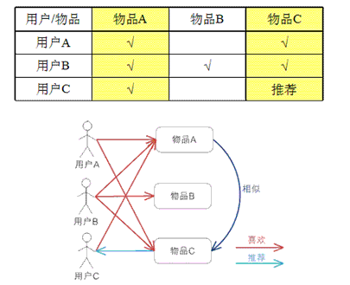
Collaborative filtering
Item-based

Slide 8
Collaborative filtering
Procedure
Collecting data
Finding similar users/items
Recommending

Slide 9
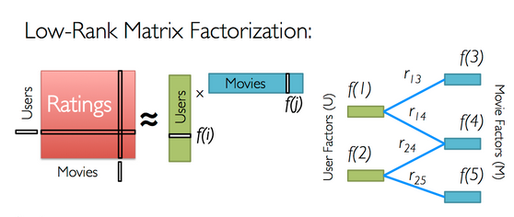
Collaborative filtering
Collecting data
<user, item, rate>

Slide 10



Collaborative filtering
Finding similar users/items
Euclidean distance
Pearson correlation coefficient
cosine similiarity

Slide 11
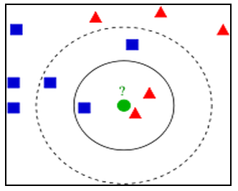
K-NearestNeighbor（kNN）
Classification / Regression
Find k neighbors which are nearest from U
U is classified by a majority vote of its neighbors
U’s value is the average of its k nearest neighbors
Weight

Slide 12
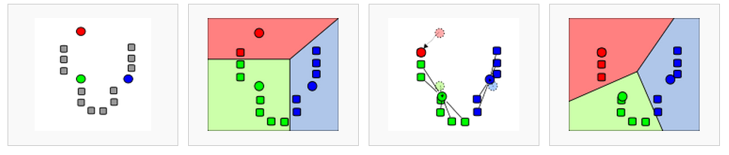
K-means
1.randomly choose k means
2.Every object chooses the nearest mean to join its cluster
3.Adjust the mean of every cluster
4.repeat 2,3 until the clusters are fixed

Slide 13
Recommendation in Gaming

Slide 14
Recommendation in Gaming
Personal recommendation result:
User classification
<user, item, rate(predicted, known)>
Grouping

Slide 15
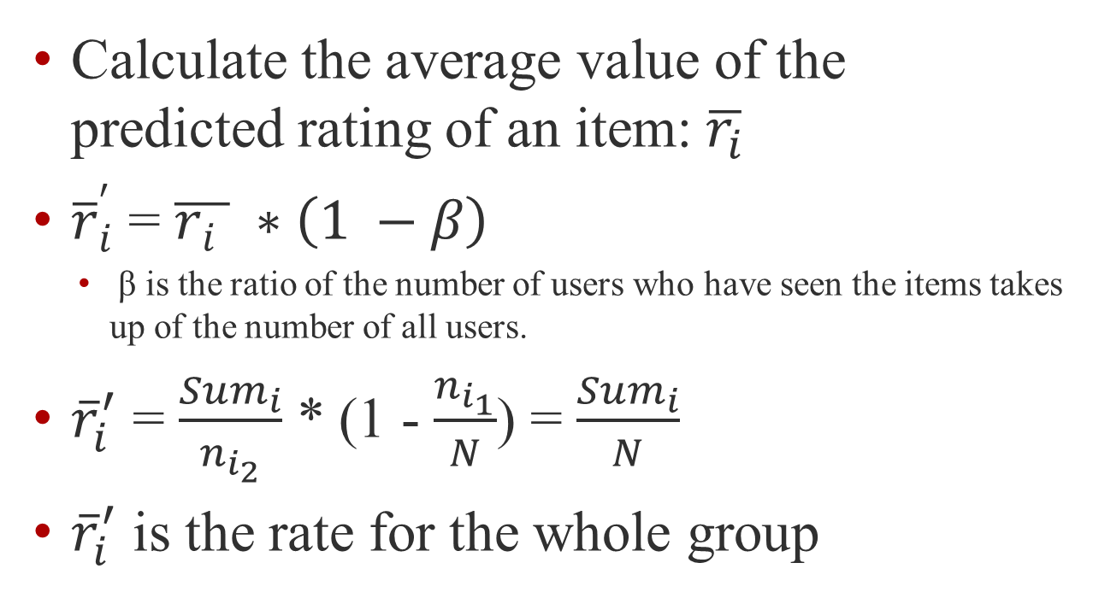
Recommendation in Gaming
Calculate the average value of the predicted rating of an item: $\overline{r_{i}}$
${\overline{r}}_{i}^{′}$ = $\overline{r_{i} } ∗\left(1 −β\right)$
β is the ratio of the number of users who have seen the items takes up of the number of all users.
${\overline{r}}_{i}^{′}$ = $\frac{{Sum}_{i}}{n_{i_{2}}}$ * (1 - $\frac{n_{i_{1}}}{N}$) = $\frac{{Sum}_{i}}{N}$
${\overline{r}}_{i}^{′}$ is the rate for the whole group

Slide 16
Future work in recommendation
Optimizing
Inter-recommendation among groups
Forcast-recommendation

Slide 17
Thank you ! Q&A Huang Kai 2014/12/19

